Slide 1
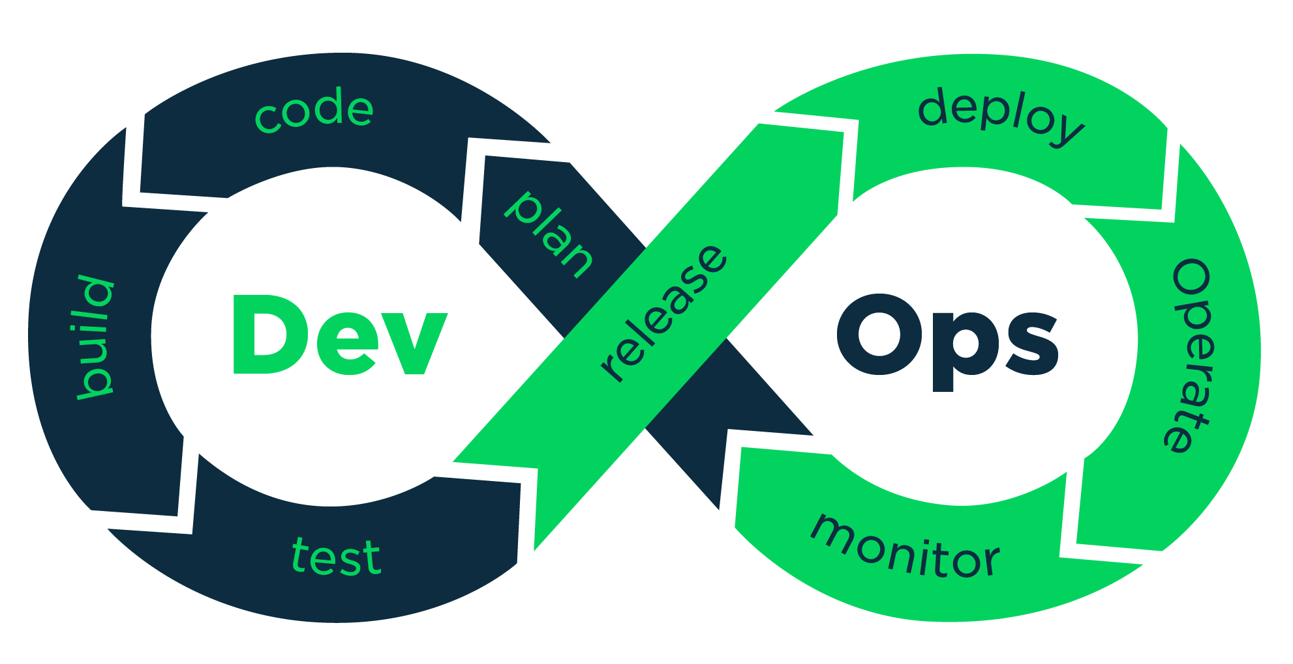
What is DevOps

Slide 2
Do you know the following :

Slide 3
Evolution of Software Development

Slide 4
Use Case 2011 : FaceBook

Slide 5
Face Book Comes Up with Dark Launching

Slide 6
The Dark Launching Techinique

Slide 7
The Dark Launching Techinique

Slide 8
What is DevOps ?

Slide 9
DevOps Tools

