Slide 1
Cloud Computing in Hacking
Quick Deployment
Virtualization technology
Automatic updates
Scalability

Slide 2
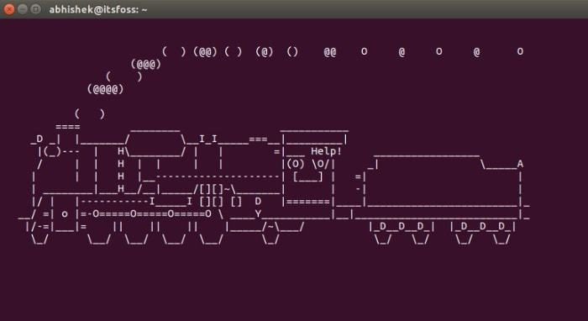
Operating system is running on remote server and you can control it from anywhere. Even with a less powerful device capable of running a web browser only. No matter how big and powerful the system is, you can operate it with a handheld device.

